Slide 1
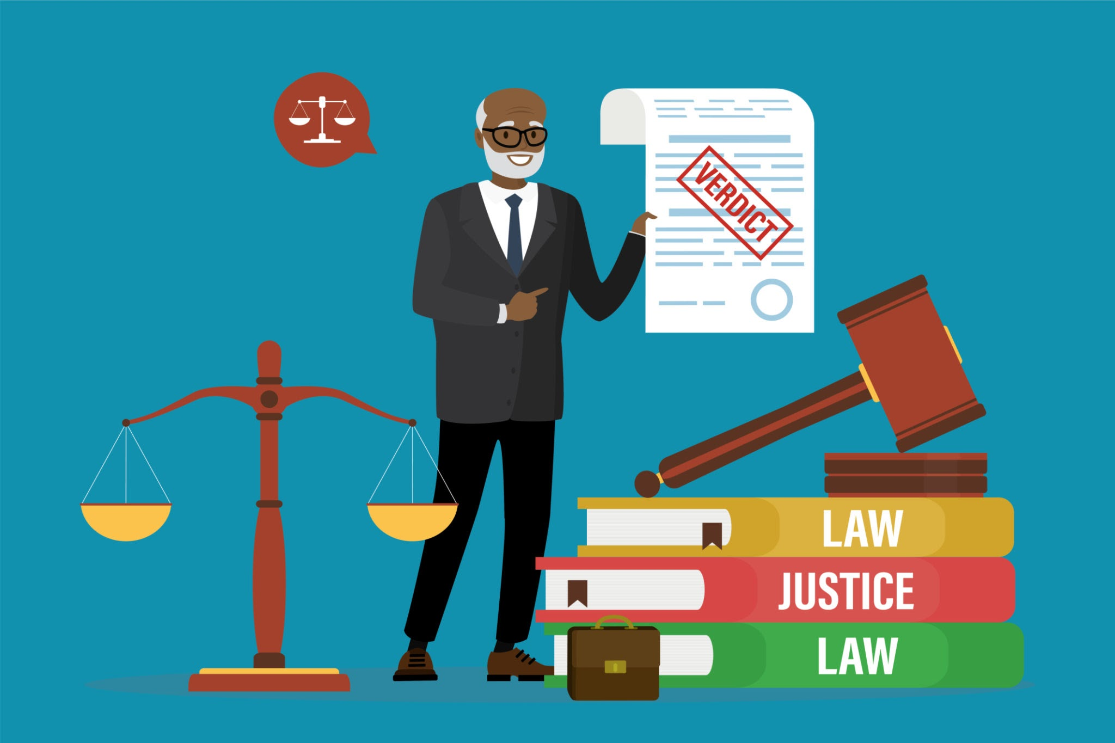
The Progression of Legal AI:
From Traditional RAG to Agentic RAG
Caroline Delva - Nandini Kodali
March 2026

Slide 2
Content
Why Retrieval-Augmented Generation Matters in Legal AI
Traditional RAG Architecture and Example
Agentic RAG Systems
Comparison: Traditional RAG vs. Agentic RAG
Conclusions and Key Takeaways

Slide 3
Why RAG Matters in Legal AI
1
Legal expertise is high-stake and expensive
2
Law is highly nuanced and context-dependent
3
RAG improves reliability by retrieving relevant legal documents before generating answers
3
4
Indexed legal data allows systems to update knowledge easily and show which documents support an answer.

Slide 4
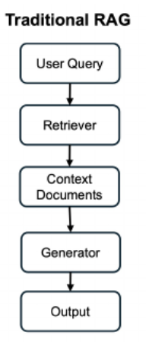
Traditional RAG
Query Encoding – The user query is converted into a vector representation.
Document Retrieval – The system retrieves the most relevant documents from an indexed corpus.
Context Fusion – Retrieved documents are provided to the model as context.
Response Generation – The language model generates the final output using that context.

Slide 5



RAG example
IQIDIS: Knowledge-Intensive RAG for Legal AI
KNOWLEDGE
INDEXING
Uses specialized legal knowledge bases to support legal research and analysis.
Legal documents are stored in indexes to enable fast and accurate retrieval.
GENERATION
TRANSPARENCY
Retrieved sources are used by the model to generate grounded legal responses.
Users can see which documents influenced the answer, improving trust and verification.

Slide 6
Agentic RAG: From Single Query to Iterative Reasoning
Feature | Naive RAG | Agentic Search
Workflow | Fixed “retrieve then read” sequence | Dynamic, multi-step process with query refinement and iterative retrieval
Decision Making | None (follows predetermined path) | Agent actively decides when and how to retrieve more information using appropriate tools
Data Sources | A single, typically unstructured knowledge base | Multi sources (internal documents, legal databases, web structured data)
Context Management | Static context window | Dynamic context building across multiple tool calls

Slide 7
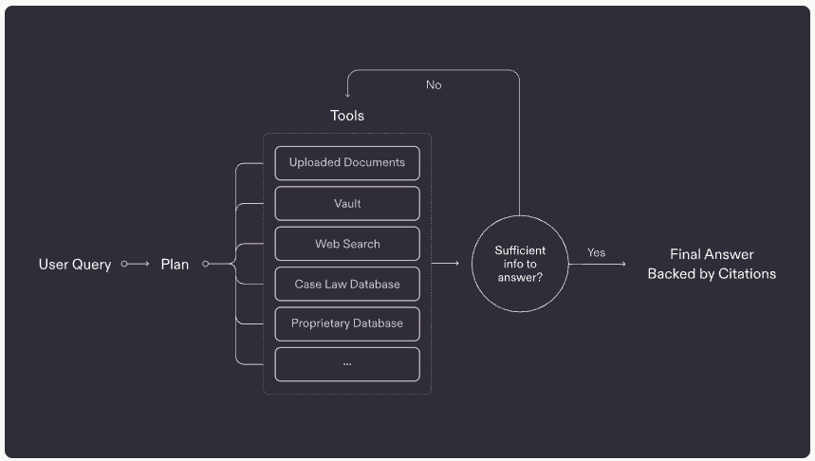
Harvey’s Agentic Search in Action
Source prediction improved from near zero to 0.8-0.9
The agent uses the ReAct reasoning loop — after each retrieval it evaluates relevance, checks for gaps, and only stops when it has enough evidence to generate a confident, citation-backed answer

Slide 8
Harvey AI: Challenges in Practice
Source Selection
Lawyers ask implicit questions like “What’s our exposure on termination provisions?”. The agent doesn't know which sources to query without explicit guidance.
Effort Calibration
Simple questions need 1-2 retrieval rounds. Complex multi-jurisdictional queries need 10+. Initially Harvey's system treated all queries the same.
Multi-Source Citation Quality
Citations optimized for a single source break down when pulling from many simultaneously. Required extensive re-benchmarking

Slide 9
Solution: Privacy-First Evaluation Flywheel
Applied Legal Researcher Develop Evaluation Datasets
Rapid Prototyping and Testing
Tool Design and System Prompt Improvements
Feedback Patterns and Support Tickets
Production Deployment
Offline Evaluation on Langsmith

Slide 10
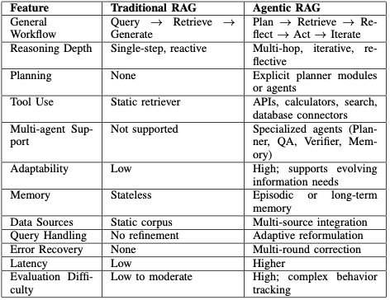
Traditional vs Agentic

Slide 11
Conclusions
Traditional RAG handles simple lookups. Agentic RAG handles how lawyers actually think.
Harvey proves it works: precisions from near zero to 0.8-0.9, upto 10 retrieval rounds per query.
The tradeoff is real: higher latency, harder to explain, requires heavy investment in evaluation.
Legal AI is going agentic.

Slide 12
Resources
Neha, Fnu, and Deepshikha Bhati. "Traditional RAG vs. Agentic RAG: A Comparative Study of Retrieval-Augmented Systems."
https://machine-learning-made-simple.medium.com/how-iqidis-uses-knowledge-intensive-rag-for-legal-ai-dd62776a4c25
https://www.harvey.ai/blog/how-agentic-search-unlocks-legal-research-intelligence

